Slide 1

UNCLASSIFIED
Overview Briefing
Global Combat Support System-Joint
UNCLASSIFIED
UNITED IN SERVICE TO OUR NATION

Slide 2
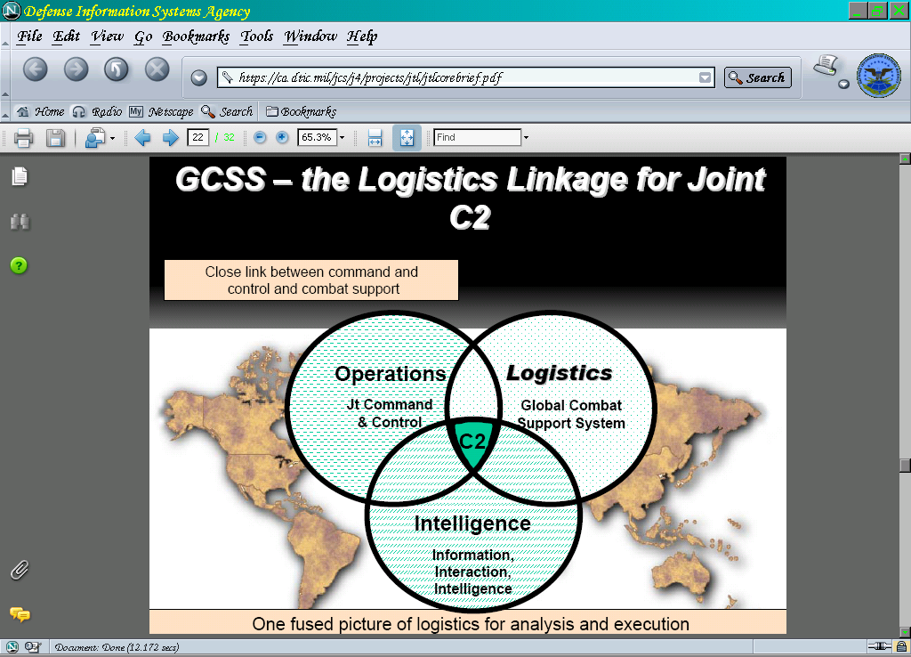
Global Combat Support System-Joint 101
Acquisition Category: 1AC
Functional Sponsor: Director for Logistics Joint Staff J-4 (DJ4)
Milestone Decision Authority: DISA Component Acquisition Executive
Operational Test Authority: Joint Interoperability Test Command (JITC)
Security Control Assessor: DISA Risk Management Executive (RE5)
Authorization Official: STRATCOM
Mission Assurance Level: MAC II
Requirements Authority: JS J4
Current Operating System: v8.1
Customers:
  Combatant Commands | Joint Task Force Commanders | Other Agencies
Operational Concept:
  Strategic Server Suites: DECC-Montgomery – Primary / DECC-St Louis – Failover
GCSS-J is the tool that eliminates “swivel seat management” for the joint logistics community

Slide 3
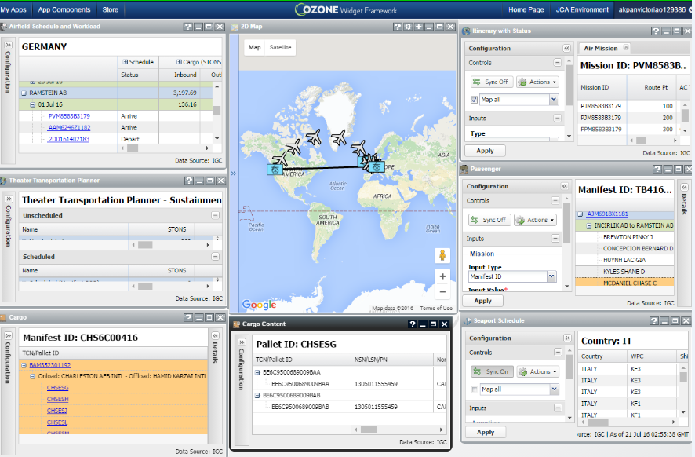
  Global Combat Support System-Joint
Provides Joint Logisticians with Visibility & Decision Support tools to Effectively
Plan & Execute Logistics Support for Current & Future Operations
Primary information technology application to provide a single source of visibility & decision support for the Joint logistician
Near real-time, web-based, accurate, actionable visibility within a Logistics Common Operational Picture (LogCOP)
Built on existing and emerging technology, products, procedures, & integration strategies
Utilizes a services-oriented architecture to link the Joint logistician to component, Service, agency, and multinational data
Links operators, intelligence, & logisticians across Joint Forces, Services, and
support agencies to enable net-centric, collaborative planning & execution

Slide 4
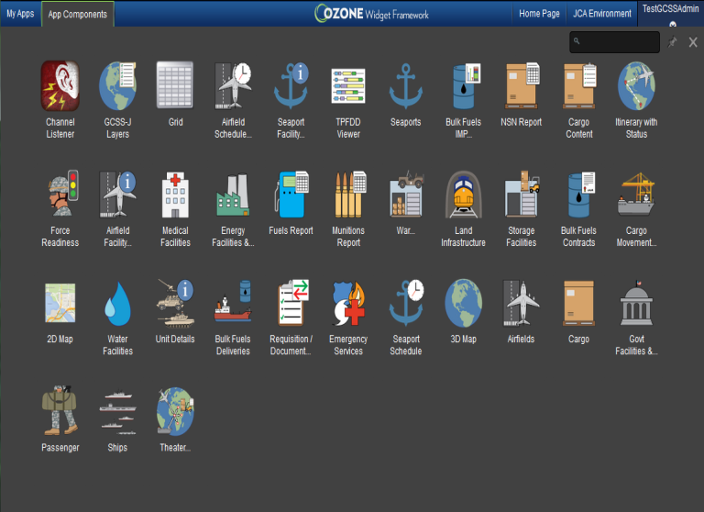
Application Components
Supply
  NSN
  Fuels / IMP Visualization
  Munitions (+ Complete Rounds)
  Requisition/Document Summary
  War Reserves/PREPO
  Theater Transportation Planner
Distribution/Deployment
  Airfields Schedule and Workload
  Itinerary with Status
      Air Mission
      Piece of Cargo
  Cargo (Ship Name or Air Mission ID)
  Cargo Contents
      By (TCN, Pallet ID Container #,RF tag ID) Passenger
      By Mission ID, Mission leg)
  Seaport Schedule
      Container Ship Only
        For Seaport and Country
Base & Installation Support
  Govt. Facilities / Military Installations
  Energy Facilities (POL/Nuclear)
  Storage Facilities (Warehouses / Cold Storage)
  Medical Facilities (Hospitals, Dental, Pharmacies, Clinics)
  Land Infrastructure (Railroads / Tunnels)
  Water Facilities (Storage,
  Emergency Services (EMS, FEMA, Fire, Law Enforcement, EOCs)
Health Readiness
  Medical Facilities (Hospitals, Dental, Pharmacies, Clinics)
Other
  2D &3D Map
  FEMA Map Layers
  KMZ Files (Map Layers)
  ACSA Status Map Layers
Planning
  TPFDD Viewer
  Force Readiness
  Unit Details
  Layer
2/8/2017

Slide 5


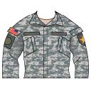
Upcoming V8.2 Capabilities
Capability | Description | Data Source
GCSS-J Virtualization | Transitions GCSS-J to a virtualized environment in preparation for going to the “Cloud.” Will not affect users interaction with the application. | N/A
Cesium Map | Provides several types of maps including imagery, street view, navigational, shaded relief, and hill shaded with all available in either a 3D or 2D globe or flat map. | Cesium
Civilian Personnel | Displays DoD civilian data including name, duty location, pay grade, occupation category, education level, and language skills. | DEERS
Military Personnel | Displays military (Active, Guard, and Reserve) data including name, duty location, pay grade, service, citizenship, service occupation, security clearance, home of record, number of dependents, and more. | DEERS

Slide 6
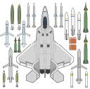

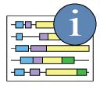
Upcoming V8.2 Capabilities Cont’d.
Item | Description | Data Source
Unit Equipment | Displays Service Unit Equipment based on Services’ property books. Includes units’ DODAAC or UICs with O/H, Authorized / Allowed quantities, NSNs, Service equipment codes: Army’s LINs, Marine Corps’ TAMCNs, and Navy’s ECCs. | IGC - AV
Material Catalog Details | Provides look-ups based on FSC, NSN, NIIN, nomenclature, or Service equipment codes. Displays NSN, nomenclature, Class of Supply, Unit of Issue, Unit Price, HAZMAT indicator, Source of Supply, Unit Pack, CAGE code, and more. | IGC -AV
OPLAN Analysis | Displays data by OPLAN ID in a grid format including UIC, UTC, ULN, C-days, RLD, ALD, EAD, LAD, RDD, total passengers, total cargo, and more. Provides filters by various C-days and GEOLOCs. | JOPES

Slide 7
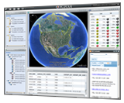

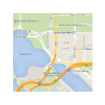


GCSS-J Capabilities
Item |  | Capability Description | Source
 | GCSS-J LogCOP | Ability to operate various Widgets in the LOGCOP. Functionality includes: 1. Launch Menu (launch Widgets) 2. Dashboards Creation & Switcher 3. Settings for users 4. Administration (administrators only) 5. Help | N/A
 | GCSS-J Layers | View and use the GCSS-J map layers for the following: 1. Master Layers (map layers set by GCSS-J, common to all) 2. Community Layers (map layers the COCOMs and Agencies import | MIDB, ONI, ITV, NGA, RPAD, DLA-CIS
 | 2D Map | Users can choose to map data on a 2D map, view all map feature icons, and all map pop-up contents. 2D map allows for icon labels on/off and allows for clustering of icons to de-clutter the view. | N/A
 | Airfields | Displays Airfields by ICAO, MILAIR or GEOLOC, includes filters for Runway Length/Width, NGA Max Usage, or AMC Suitability. Mappable, and synchronized with Airfield Schedule and Airfield Facility Details widgets. | NGA-AAFIF GDSS
 | Airfield Facility Details | Displays General Airfield info, Runways, Aprons, Hardstands, Helipads, Taxiways, and Suitability for a given ICAO, GEOLOC or MILAIR code. Synchronized with the map and Airfield Schedule widget. | NGA-AAFIF GDSS

Slide 8




GCSS-J Capabilities
Item |  | Capability Description | Source
 | Airfield Schedule & Workload | Displays the Airfield Schedule for a specified Airfield and Country within a date range. Workload data including Inbound, Offload, Onload, and Outbound for Passengers, Pallets, & Rolling Stock. Mappable and synchronized to other widgets. | IGC Web Services
 | Mission Itinerary | Displays an itinerary for Aircraft Missions. Input is Mission ID. Added Status indicating Early, On-Time or Late. Available on NIPR/SIPR. Mappable and synchronized with the Airfield Schedule, Cargo and PAX widgets. | IGC Web Services
 | Cargo Itinerary | Displays Cargo Shipment Status and Itinerary for any of the following inputs: TCN, Pallet ID, Container Number, and RF Tag. Sync’s with Cargo, Cargo Contents, and Mission Itinerary. Hyper-links for TCNs. | IGC Web Services
 | Passenger Itinerary | Displays Passenger Names based on name search. Includes Passengers Itineraries for a data range, passenger information and status. Available on NIPR/SIPR. | IGC Web Services
 | Seaports | Displays Seaports for a specific MILSEA or Synchronize with map requiring no initial input includes a filter for Channel Depth. Mappable and synchronized with the Seaports Schedule and Seaport Facility Details widget. | NGA-WPI JOPES-GEOLOC
 | Seaport Facility Details | Displays General Seaport information, Physical Characteristics including Max Size Vessel, Cargo Pier Depth, and Berth Information including Draft, Length, S-tons and M-tons. Synchronized with map and Seaport Schedule widgets. | NGA-WPI IRRIS

Slide 9




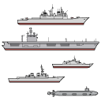

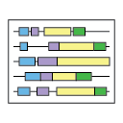
GCSS-J Capabilities
Item |  | Capability Description | Source
 | Seaport Schedule | Displays Seaport Schedule (Container Ship only) for a Seaport and Country within a date range. US Flagged Ships are mappable and synchronized to other widgets. | IGC Web Services
 | Cargo | Displays cargo associated with a Ship Name or Air Mission ID. Ships filters are by Status and cargo POD. Air cargo is displayed with Mission ID by Onload and Offload locations. Added UIC and ULNs. Synchronizes with Cargo Content widget. | IGC Web Services
 | Cargo Contents | Displays the cargo items associated with a specified Container, Pallet, RF Tag, or TCN. Added different outputs dependent on the Input utilized. Synchronized with Cargo and Cargo Itinerary widget. | IGC Web Services ITV (RF Tags)
 | PAX | Displays the Passengers associated with an airlift Mission ID. Lists of passengers are displayed by mission leg. Available on NIPR / SIPR. Synchronized to Mission Itinerary and Cargo widgets. | IGC Web Services
 | Ships | Displays US-flagged ships by Ship Name, UIC, or Ship Type (Carriers, Destroyers, Oilers, General Cargo, Coast Guard, etc.). Synchronized with the map. When mapped with Fuels and Munitions Widgets will display Fuels and Munitions Icons above Ship. | ONI
 | Force Readiness | Displays unit readiness details from GSORTS or DRRS –S (when fielded) filterable by Geographical Region, Service, Component, Unit Role, UTC, UIC, Readiness Type, Readiness Category, and Readiness Rating. Mappable and synchronizes with map. | GSORTS (DRRS when fielded)
 | TPFDD Viewer | Displays a graphic visualization of a TPFDD for a specified OPLAN, with filtering by: ULN, UTC, EAD, LAD, RDD, POD, POE, Destination, Origin. Added a filter by GEOLOC. Results are mappable. | JOPES

Slide 10




GCSS-J Capabilities
Item |  | Capability Description | Source
 | TTP - Sustainment | Displays all Sustainment PAX and Cargo by Unscheduled and Scheduled. Includes HAZMAT codes and STONs. | IGC Web Services
 | TTP – Unit Move | Displays all Unit Moves by OPLAN ID and ULN. Includes Unscheduled and Scheduled PAX and Cargo. | IGC Web Services
 | Cargo Movement | Displays Retrograde distribution (Afghanistan only) including RPADs and TCNs. Additional data from Army’s LIW (NIPR only) is included. Develop in conjunction with TRANSCOM | IGC Web Services LIW (Army)
 | Unit Details | Displays Unit Information including General data, Location data, Readiness, Equipment, Personnel, and OPLANS (JOPES users only). | GSORTS (DRRS when Fielded) JOPES
 | Requisition / Document Summary | Displays Requisition or Document Numbers for a DODAAC, or NSN/LSN/PN by last status date. Filters include COCOMs and Priority Codes. Requisition and Document Numbers individually are synchronized with the Details portion of widget. | IGC Web Services
 | Requisition / Document Details | Displays all transactions in status date order for a single Requisition or Document Number. Displays History, Last Status, and Shipment Status. Filters include Priority Codes and Suffix. TCNs shown on DICs of AS_ are hyper-linked to Cargo and Cargo Contents widgets. | IGC Web Services

Slide 11





GCSS-J Capabilities
Item |  | Capability Description | Source
 | NSN/ NIIN | Displays Wholesale/Retail inventories based on user specified Commodity Groups and Supply Points (DODAACs). Results are displayed in a hierarchical structure that summarizes quantities to the CCMD level. User allowed to save Commodity Groups and entire report for re-use. Supply Points are mappable. | IGC-AV
 | Munitions | Displays Munitions Inventory data for all DODICs and NALCs by user specified Commodity Groups and Supply Points including Ships. Includes Complete Rounds and All-Up Rounds in separate Tab. Displayed in a hierarchical structure that summarizes quantities grouped either by CCMDs or by Supply Points such as Ships. | NLAC (includes all 4 Services) OIS, GAC-P
 | Fuels IMP Visualization | Graphically displays the Inventory Management Plan for a given DODAAC and Fuels Product Code, selectable from a pick-list organized by CCMD / Country/State. The current inventory is superimposed on the graphic. | IMP (via spread-sheet) EEPB REPOL
 | Fuels | Displays Fuels Inventory data for Fuels Product Codes including ships. Includes PWRR (Petroleum War Reserve Requirement) and other IMP data for site by Product Code. Mappable including ships. | EEBP Web REPOL IMP
 | Bulk Fuels Contracts | Displays all DLA Energy Fuels Contracts for Into-Plane, Post, Camp, and Station (PC&S), and Bunkers. Data includes contract number, vendor, fuel type, quantity in contract, and mode. Into-Plane Fuels Contracts are mappable. | DLA-CIS or (DLA-Energy)

Slide 12




GCSS-J Capabilities
Item |  | Capability Description | Source
 | War Reserves | Displays Army Pre-positioned Stock (APS) On-Hand quantities. Inputs / filters include: APS, Location, Storage RIC, Project Code, UIC, Nomenclature, NSN, LIN, FSG/FSC, and Supply Class. Report Visualization Options: View by FSC, UIC, or Project Code. Mapping results is by Storage RIC. | IGC-AV
 | Munitions Prepo | Displays all Land-based and Afloat Prepositioned Munitions stocks for Army, Marine Corps, and Air Force. Ships are organized by Service unique identifiers. Part of War Reserves Widget. | NLAC
 | Ships with Munitions, Fuels, NSN, & Munitions Prepo | The combination of the Ships Widget and any combination of Munitions, Fuels, NSN, or Munitions Prepo Widgets will provide the appropriate supply icon above the ship in which the supply On-Hand quantities are on-board the ship. Ships include Navy, Military Sealift Command (MSC), and Coast Guard. | ONI, NLAC, EEPB, IGC-AV
 | ACSA Map Layer | Displays the current state of all Acquisitions & Cross Servicing Agreements (ACSA) US has with countries. Includes color display on map with statuses of Indefinite, Expiring, Eligible, and Not Eligible Countries. | ACSA Intellipedia
 | Energy | Displays Nuclear, Oil and Petroleum Facilities for US(Civilian) and Non-US countries including Refineries, Storage/Tank Farms, Gas Stations, and Nuclear Fuel Plants. Synchronized with the map. | MIDB (SIPR only) HSIP
 | Storage Facilities | Displays World –Wide Military and Non-Military Storage Facilities for US (DoD/Civilian) and Non-US countries including Cold Storage and Warehouses. Synchronized with the map. | MIDB (SIPR Only) HSIP RPAD

Slide 13





GCSS-J Capabilities
Item |  | Capability Description | Source
 | Govt. Facilities & Military Installations | Displays Government and Military Installations for US (DoD) and Non-US countries including Non-US countries Government Bodies, Defense Ministries, and Bases. Synchronized with the map. | MIDB (SIPR Only) HSIP RPAD
 | Land Infrastructure | Displays Railroads and Tunnels for US (DoD/Civilian) and Non-US countries including Highway and Railroad Tunnels, Railroad Yards, and Nodes, Change of Gage, and Change of Mode. Synchronized with the map. | MIDB (SIPR Only) HSIP
 | Emergency Services | Displays EOCs, FEMA Facilities, EMS, Hurricane Evacuation Routes for CONUS. Displays Fire Stations and Law Enforcement for US (DoD/Civilian) and Non-US countries. | MIDB (SIPR only), HSIP RPAD
 | Water | Displays Water Sources and Storage for US (DoD/Civilian) and Non-US countries including Wells, Reservoirs, Potable and Non-Potable Storage facilities. Synchronized with the map. | MIDB (SIPR only) HSIP RPAD
 | Medical Facilities | Displays Medical Facilities for US(DoD / Civilian) and Non-US countries including Hospitals, clinics, Blood banks, Pharmacies, and Medical/Dental clinics. Synchronized with the map. | MIDB (SIPR only), HSIP RPAD

Slide 15
Title
Text
9 January 2017

